Slide 1
Comparative Tools

Slide 2
Comparative Genomics Tools
Several ways to compare PGDB data
All relevant PGDBs must be loaded into one instance of Pathway Tools
Compare objects across databases
Metabolic map comparisons
Compare genome regions around orthologous genes
Web-based comparative analysis tables

Slide 3
Second Database Selector
There are two different organism selectors in BioCyc
The first: found at the top of the page, selects a single organism/database
The second: a multi-organism selector, used for comparative analyses
Tools → Comparative analysis ; Choose Organisms button
On gene page: Genes → Select organisms/databases for comparisons

Slide 4
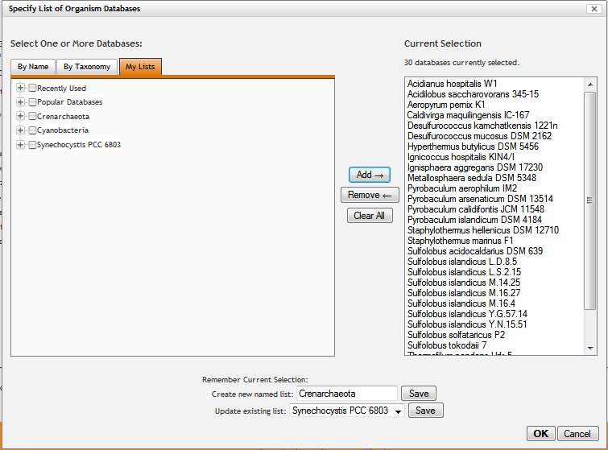
Save Organism Groups with Web Accounts
Note My Lists tab on the multi-organism selector for comparative analyses
You can save groups of organisms for re-use at a later time

Slide 5
Show how to use multiorganism selector
Select by name, taxonomy, from lists

Slide 6
Compare Objects Across Databases
Web mode
Find object in one other database
Gene -> Show this gene in another database
[Type] -> Show this [type] in another database
Find object in multiple other databases
[Type] -> Select organisms/databases for comparison operations
[Type] -> Show this [type] in multiple databases
Desktop mode
Right-click Show -> Frame in other DB
What does it mean for two objects to be the same?
Genes: same name or ortholog
Proteins: same name
Reactions, Pathways, Compounds: same object ID

Slide 7
Pathway Comparison
Use Species Comparison button on pathway pages
Is the pathway inferred to be present?
Evidence glyph
Green – reaction has an associated enzyme in this organism
Blue – the Hole Filler has predicted an enzyme for this reaction
Black – no enzyme, sorry
Orange – within this PGDB, this reaction is only assigned to this one pathway
Magenta – spontaneous reaction, or the mysterious “other”
Enzymes and associated genes list
Grouped by reaction
Operons
Shows pathway genes in their TUs

Slide 8
Compare Metabolic Maps Via Cellular Overview
Overviews -> Highlight -> Species Comparison
Desktop mode only
A reaction is shared between two PGDBs if,
for both PGDBs:
The reaction occurs spontaneously, or
An enzyme is present that catalyzes the reaction
If the same reaction exists as a pathway hole in two PGDBs, it will not be highlighted

Slide 9
Compare Genome Regions
See a gene and its orthologs in their respective contexts
Genes coding for pathway enzymes
And how those genes are organized
Gene page:
Gene → Align in Multi-Genome Browser

Slide 10
Web-based Comparative Analyses
Generate tables comparing the presence of biological entities in different organisms
Select what you want to compare
Select the organisms you want to compare
Will generate a table with items you can click through on

Slide 11
Comparative Analysis Example
Select Pathways and three organisms
Multiple tables result
Pathways by class
Presence of pathway holes
Each type of item (pathways, reactions, etc) has different tables
Clicking on a pathway class generates a table comparing the actual pathways within that class
Can then click through to cross-species comparison (like from the pathway pages)

